Slide 1
Collabo- The Team Connector
Submitted in the partial fulfillment for the award of the degree of
BACHELOR OF ENGINEERING
IN
COMPUTER SCIENCE & ENGINEERING
WITH SPECIALIZATION
IN MOBILE COMPUTING
Submitted by:
Anand Svarup Bhatia(19BCS4257) Utkarsh Chauhan (19BCS4270)
Bommagani Veerender Goud (19BCS4265) Shubham Mahajan (19BCS4275)
Mallela Srilakshmi Venkata Phanendra Babu (19BCS4279)
Under the Supervision of:
Ms. Leeza Sharma
Department of AIT-CSE
DISCOVER . LEARN . EMPOWER

Slide 2
Outline
Introduction to Project
Problem Formulation
Objectives of the work
Methodology used
Results and Outputs
Conclusion
Future Scope
References

Slide 3
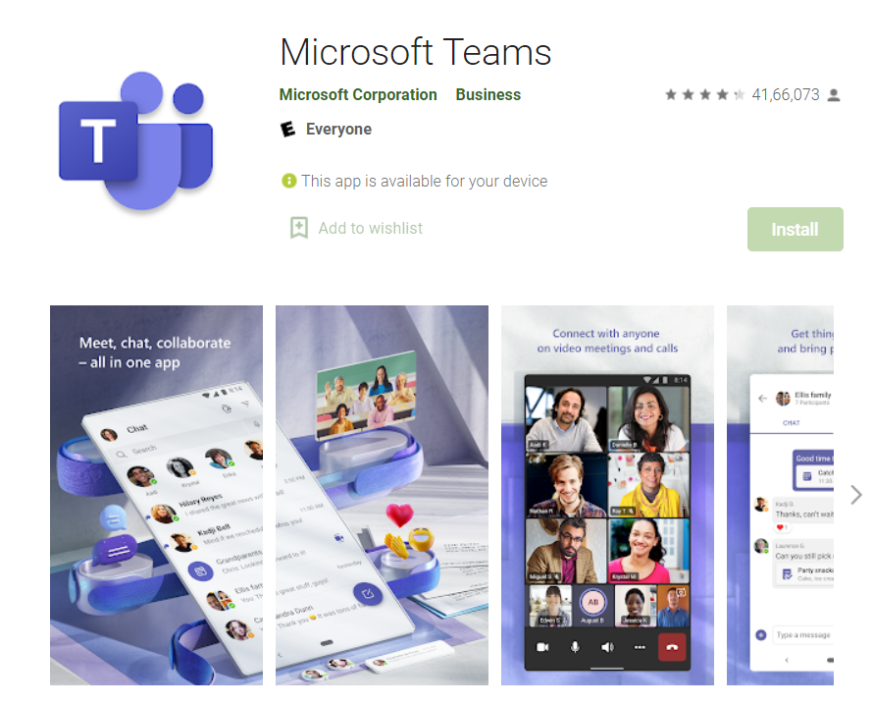
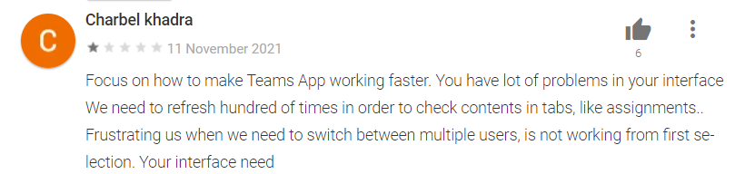
Introduction to Project
PROBLEM DEFINATION:
While searching for a good collaboration tool we came across few apps such as Trello, teams, jam board but all of these were having adware or subscription model or less than desired features.

Slide 4
PROBLEM OVERVIEW:
The application is based on a collaboration like platform where people can collaborate on a specific task by creating groups called as boards. The backend is designed through firebase which supports latest API and is also scalable.
The application supports latest API of the android framework which provide a very memory efficient design on the operating system level along with support of android native theme engine.
The application is Ad Free and has no trackers so that users can do their work smoothly while also maintaining the privacy policies. The User Interface is non cluttered and user friendly so that new users can quickly get used to the app.

Slide 5
Problem Formulation
During software development, the main problem with existing app is
It lacked features for free version.
It had expensive subscription fees.
Basic collaboration tools were limited in premium version too.
App took a lot of space in phone.
Cluttered UI.
The Problems were tackled by:
App made will be totally free.
No subscription fees or Ad-ware in the app.
Unlimited Members can be added to a board.
No limit on Number of active boards per user.
Easy to use clutter free UI.

Slide 6
Objectives
Since this pandemic many corporates have allowed work from home, there was mismanagement of work due to lack of coordination.
This app aims to lessen the impact of this by making dynamic boards which can be used by companies to make division of work between the team easy.
The Existing solution had limitation and subscription fees which makes it not access able to a common man.
The main aim of collabo is to give collaboration tool in hand of common man free of cost.
This tool can not only be used by big companies but also can be used in households like grocery or vegetable list making etc.

Slide 7
Methodology used
Detailed study of various collaboration systems will be done.
Installation and hand on experience on existing approaches of collaboration systems will be done. Relative pros and cons will be identified.
Various parameters will be identified to evaluate the proposed system.
Comparison of new implemented approach with existing approaches will be done.
Feedback will be taken from research.
New ideas will be implemented to eliminate cons.
New features will be implemented to enhance user experience.

Slide 8
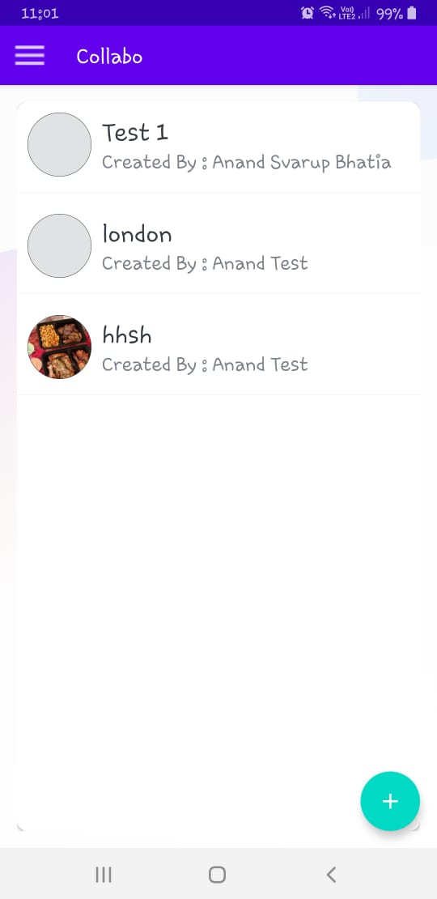
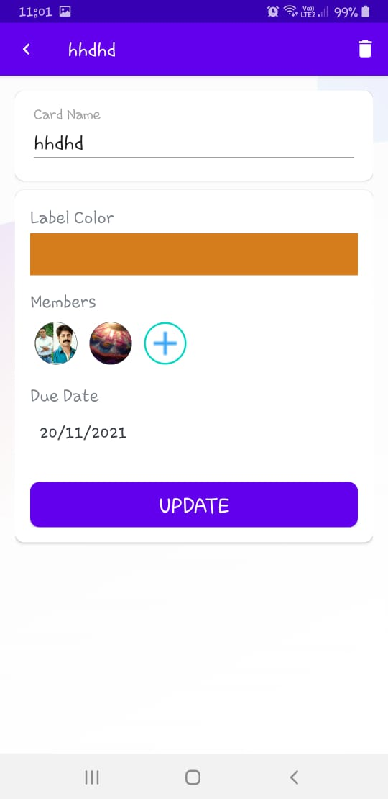
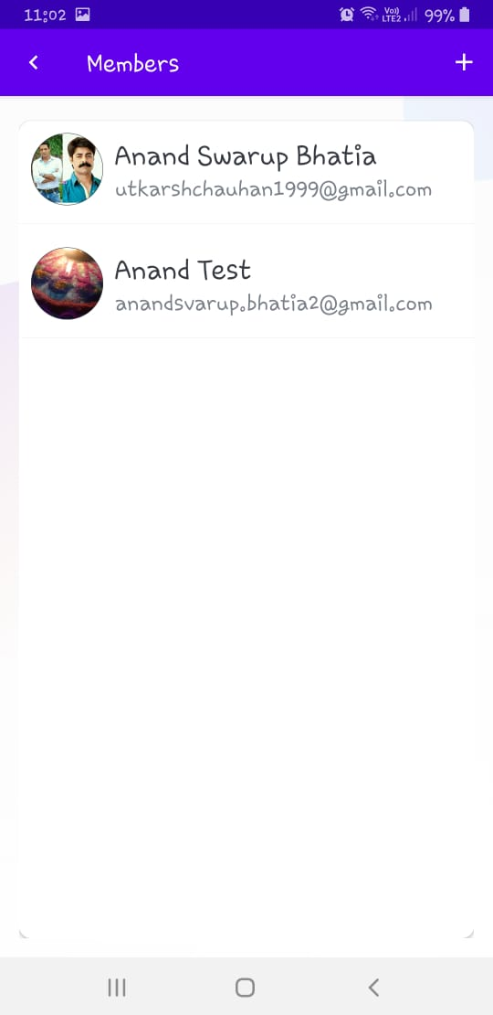
Results and Outputs

Slide 9
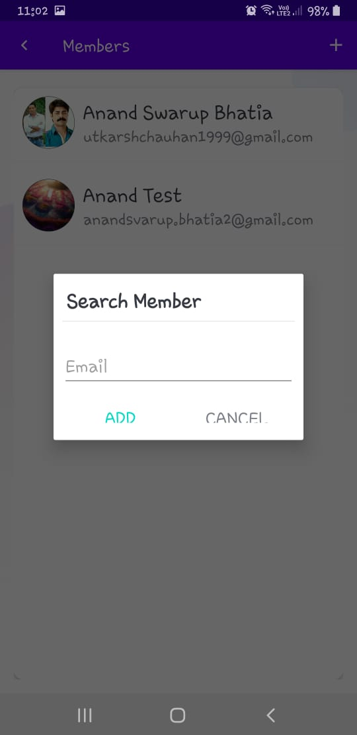
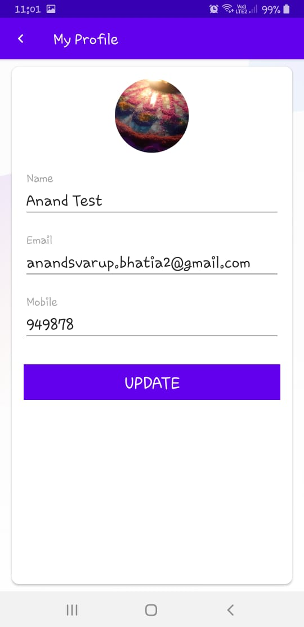
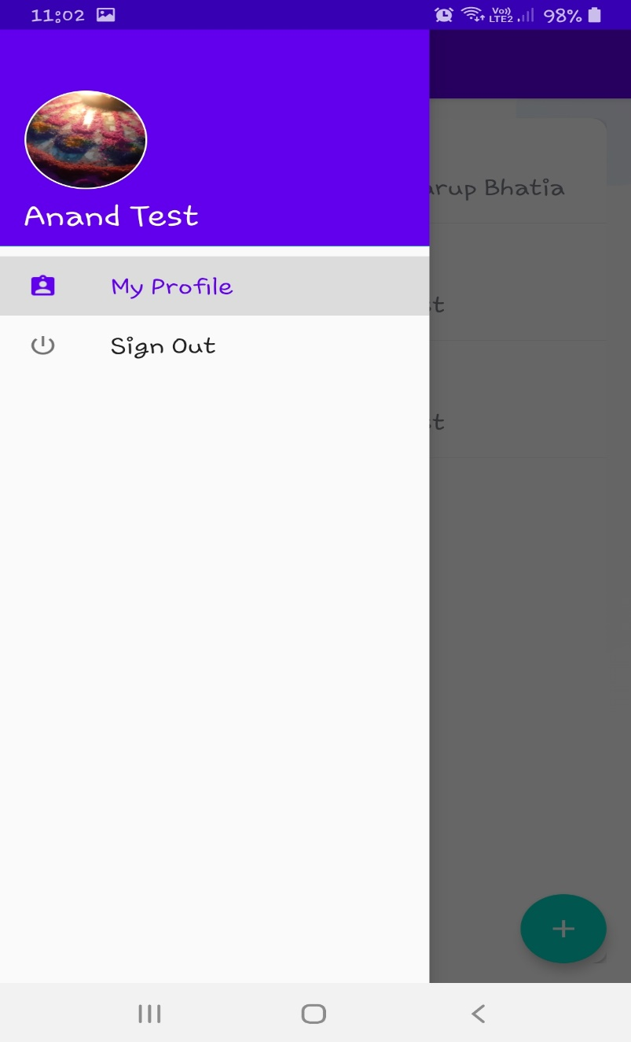

Slide 10
Conclusion
As one can observe that the app is very much ready for daily usage incorporates and families. By implementing a basic UI and applying app smoothening the product turned out to be very light and easy to use, no adware or subscriptions make it more access able. The tester is satisfied with the workout and gives very positive feedback.

Slide 11
Future Scope
Few features that can be added to make it more productive are:
Company calendar integration which automatically imports deadlines of things.
Audio call/ video call between people who are sharing a board.
Export the board as PNG/JPEG file.
Setting a viewer only mode where i person can only see what is happening without interrupting.
Chat option between team members.

Slide 12
References
https://developer.android.com/guide/topics/data
https://developer.android.com/guide/user-data
https://developer.android.com/guide/topics/ui
https://developer.android.com/guide/components/intents-filters
https://firebase.google.com/docs/android/setup
https://firebase.google.com/docs/auth/android/firebaseui

